Slide 1
Optimized GPU-Based Thermal Simulation of CPU Floorplans
Alec Roessler

Slide 2
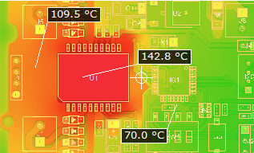
Why GPU Thermal Simulation?
Modern CPU’s and other chips are denser and faster than ever, this inherently creates more heat as more transistors are condensed into a smaller area
Thermal simulation in the design process is critical before expensive production fabrication can begin
Due to the parallel nature of thermal simulation algorithms, this makes a great application for GPU’s

Slide 3



Poisson Steady-State Heat Equation
Where: $α= \frac{k}{ρc_{p}} \left(thermal diffusivity\right)$
q = volumetric heat generation rate $\frac{W}{m^{3}}$
$ρ=$material density
$c_{p}=$specific heat capacity
$k=thermal conductivity (150 for silicon)$
T = temperature field (starting at 25 degrees Celsius)
General Form:
For continuous, steady-state, time-independent system
$$α∇^{2}T+ \frac{q}{ρc_{p}}=0$$
Rearranging and substituting α, the equation becomes:
$$∇^{2}T=−\frac{−q}{k}$$

Slide 4

Jacobi Iteration
Finite difference approximation:
Discretizing the Poisson generalized equation involved sampling the four neighboring previous temperature values surrounding the element
h = spacing between elements
$$\frac{∂^{2}T}{{∂x}^{2}}+\frac{∂^{2}T}{{∂y}^{2}}≈\frac{T_{top}+T_{bottom}+T_{right}+T_{left}−4T(x,y)}{h^{2}}$$
Discrete Jacobi Iteration:
Dirichlet's Boundary Condition: Boundary points are fixed (in our case at ambient temperature)
Simulation will be ran until convergence (for this demonstration that is until max, element wise temperature change is $≤$ 0.001)

Slide 5
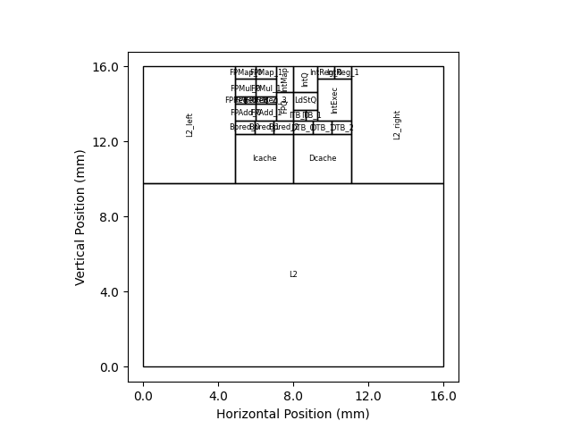
Floorplan Extraction
To implement the simulation, q (power density map) needs to be created
This involves first acquiring a floorplan of the target chip, for this demonstration the Alpha EV6 Processor was used as the floorplan was easily accessible through Hotspot (UVA)
The floorplan describes the dimensions and locations of all major functional blocks including caches, ALU’s, and registers, among others.

Slide 6
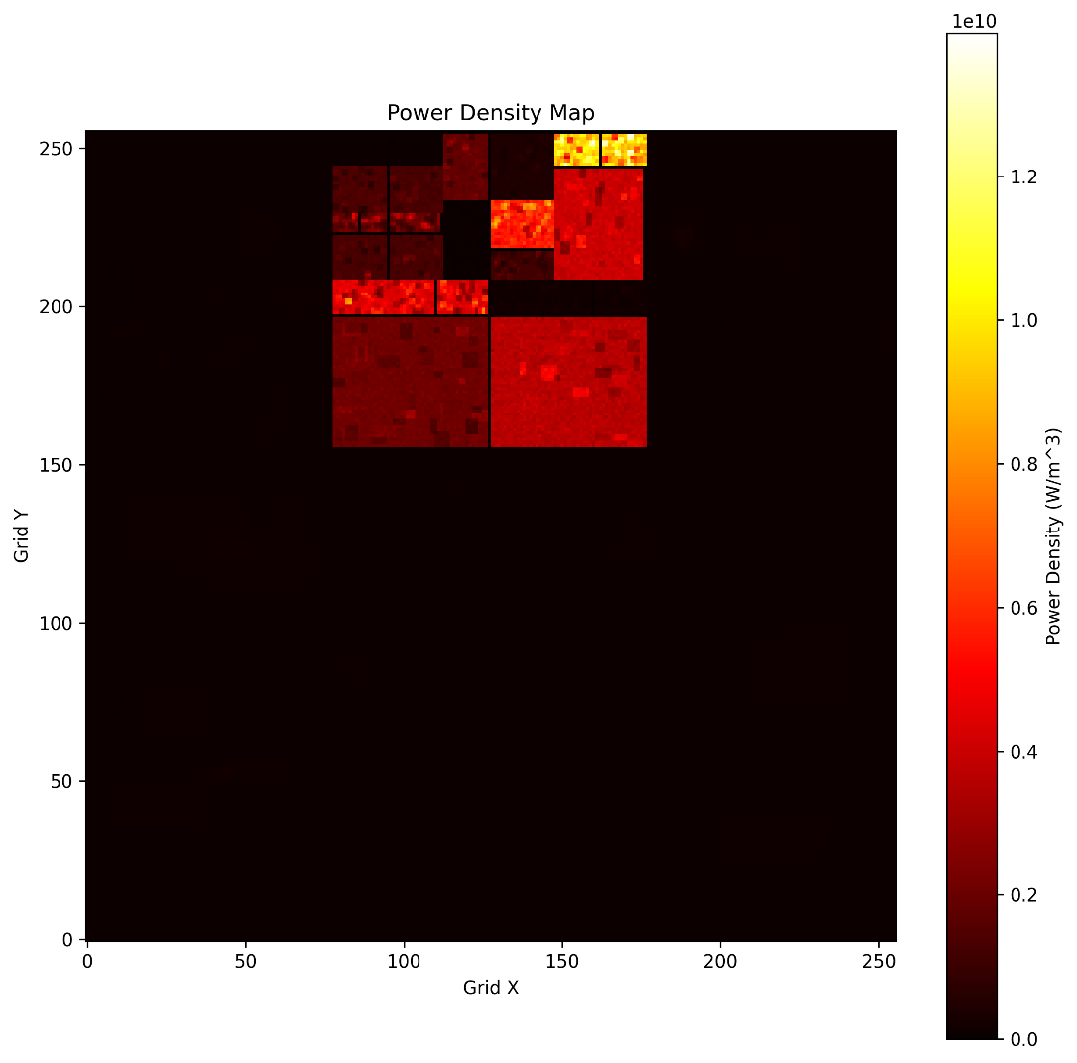
Power Map Creation
Provided with the floorplan from Hotspot is power trace file which describes each floorplan components power draw over a realistic program ran on the processor
This can be used to extrapolate a detailed power density map which involves:
1. Breaking the grid into finder elements (256 x 256)
2. Adding random deviations and Gaussian noise to generate a more accurate map
3. Normalizing the sum of all elements in each block to equal that of the power trace files first row
4. Power map can be transformed to power density map by dividing by the elements area

Slide 7
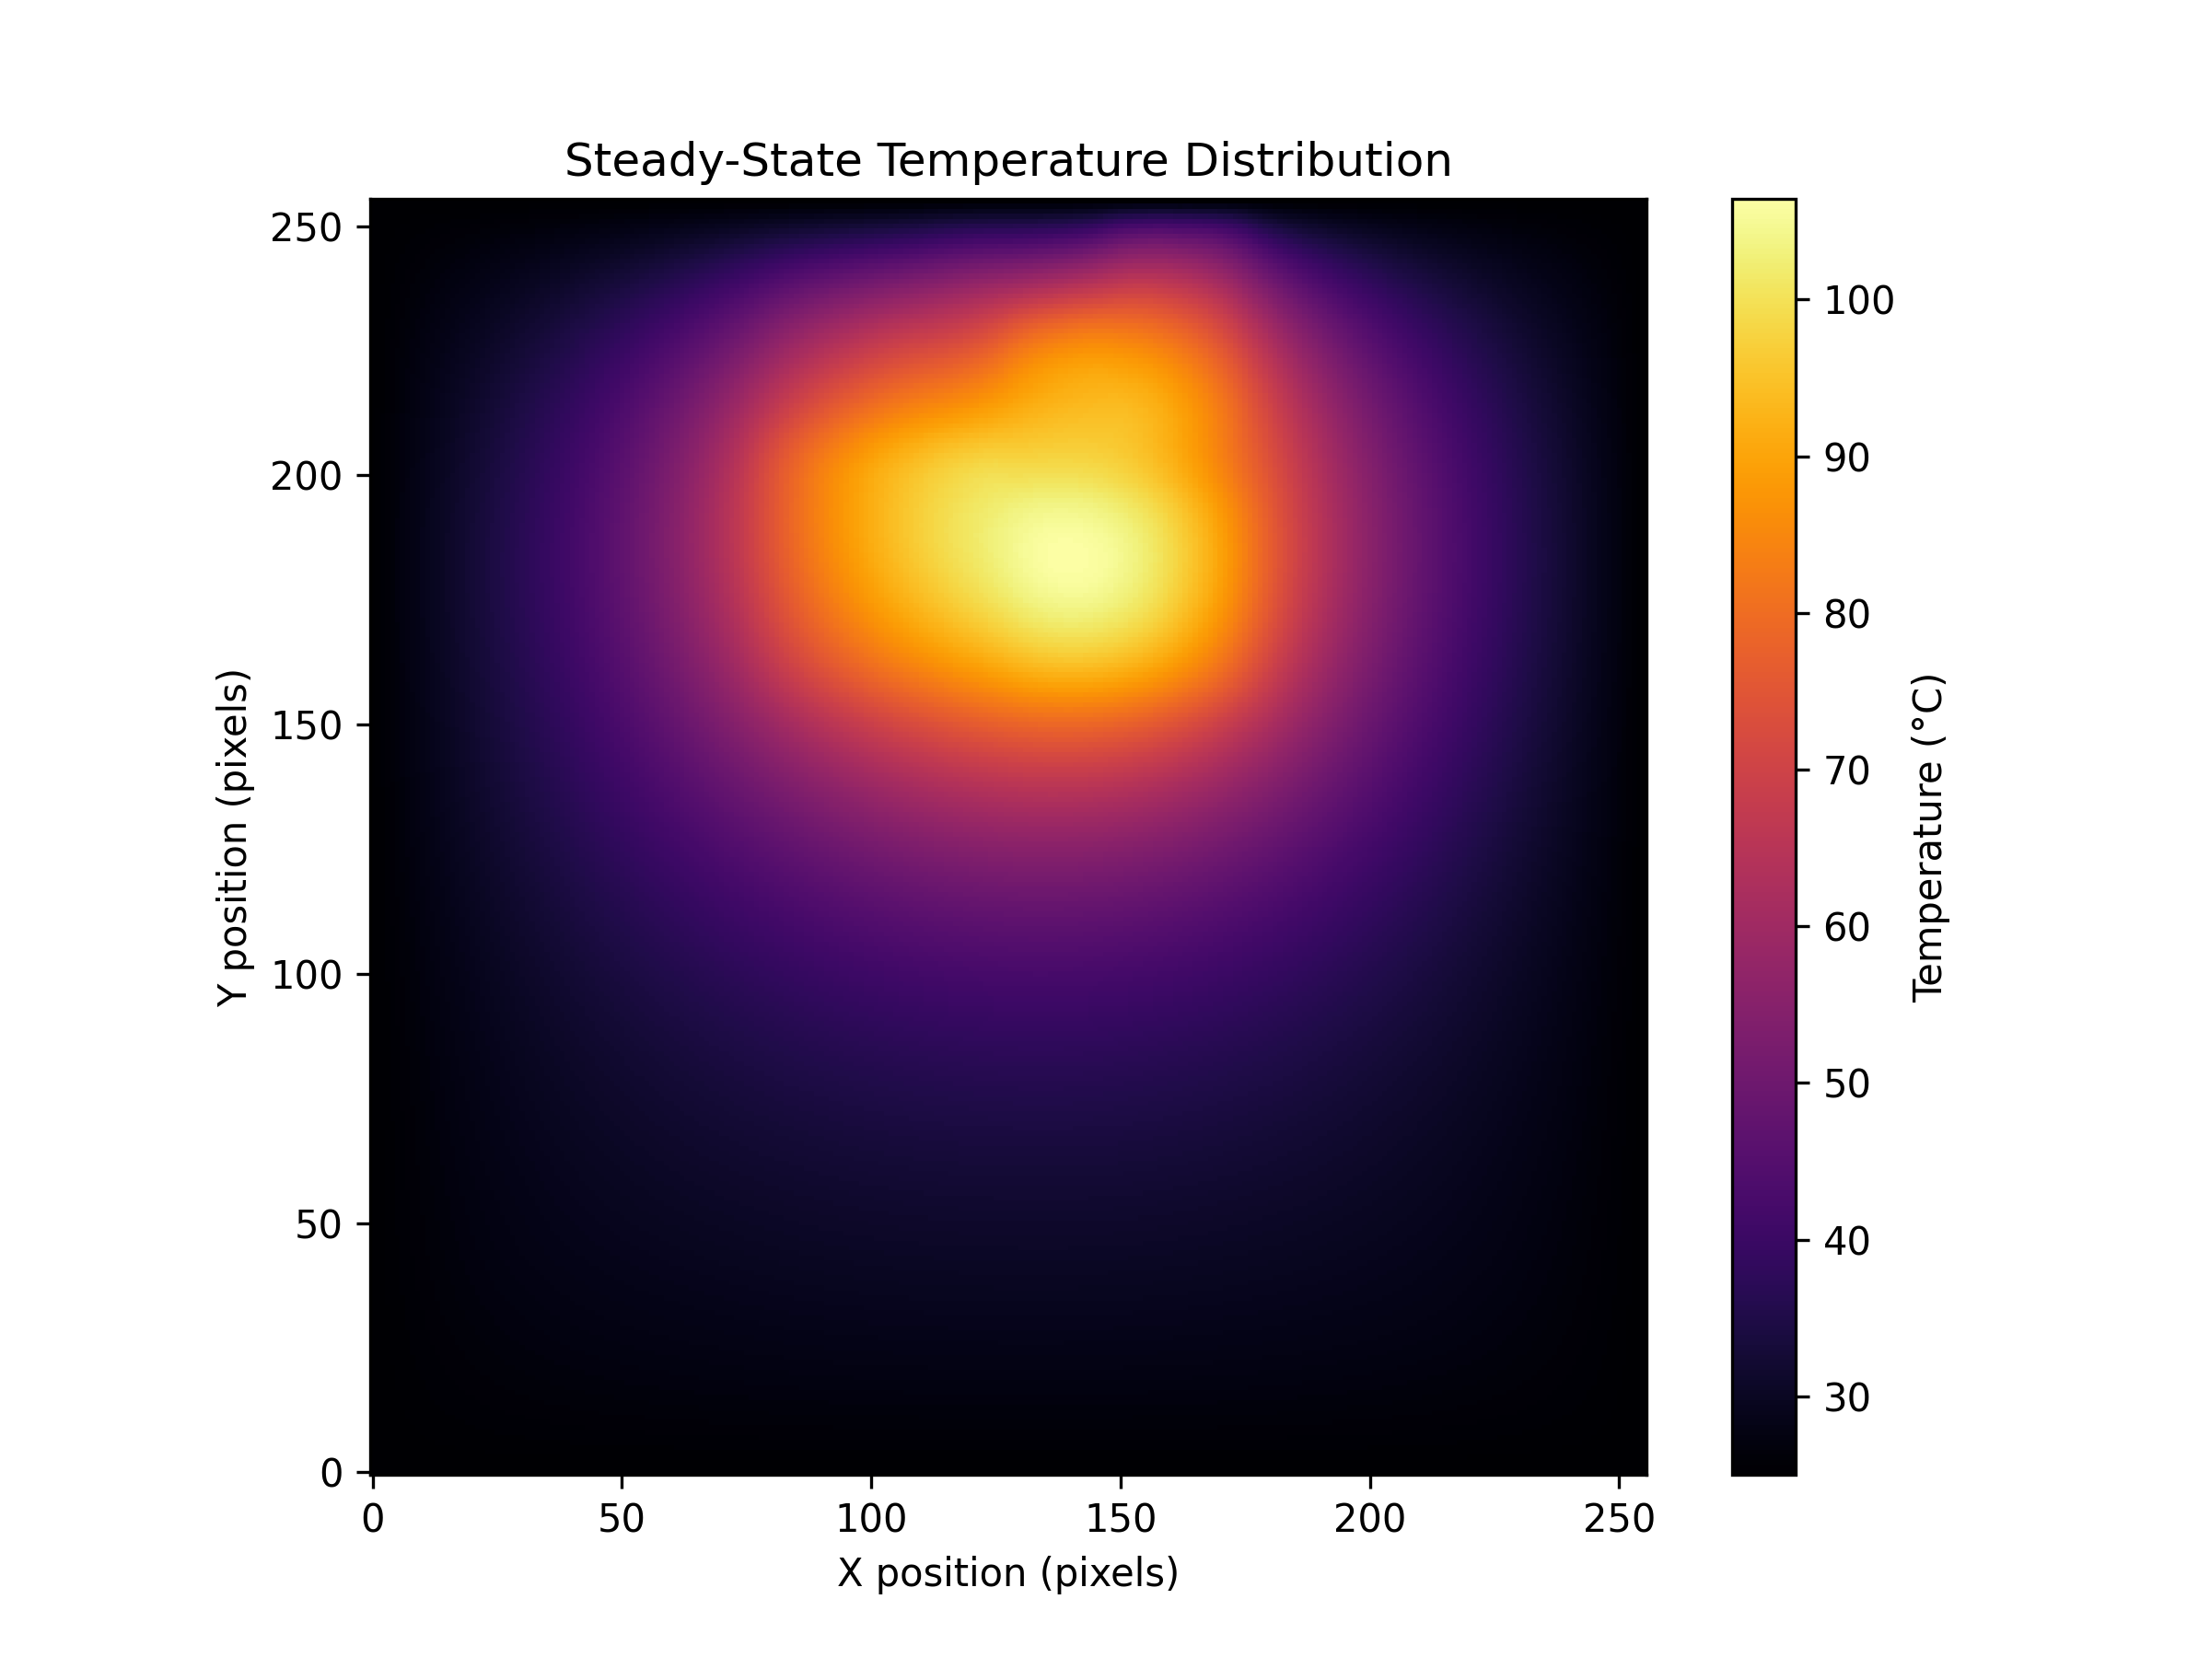
Serial Implementation of Algorithm
Q , T, and T_new arrays are initialized with size 256 x 256
Power density map is loaded from stored CSV file
Initialize T with ambient temperature (25 C)
Implement algorithm
- Each element in T_new is computed
- Dirichlet boundary conditions are applied
- Max element-wise change is calculated
- Convergence check
- T_new copied to T array
Max, min, average final temperatures recorded along with simulation time
Total execution time is recorded

Slide 8
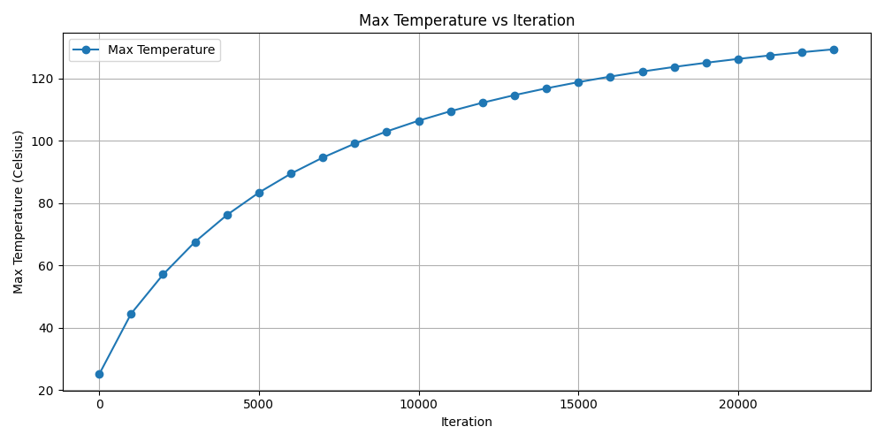
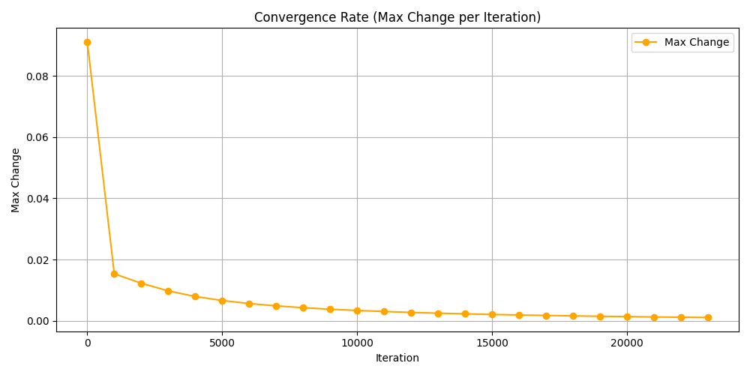
Results
Max Temp: 130.00 C Min Temp: 25.00 C Avg Temp: 52.32 C
Total Execution time: 30.87 s Simulation time: 30.85 s

Slide 9
Naïve Cuda Implementation
Assign constant parameters
Load power density map
Initialize and allocate host arrays q_h, T_h, and T_new_h
Allocate corresponding device arrays q_d, T_d, and T_new_d
Copy data from host to device
Define grid and block dimensions
7. Launch CUDA kernel:
- Each thread computes an element in T_new_d
- T_new_d is copied back to host memory
- Compute max change in arrays
- Convergence check
- Swap T_d and T_new_d pointers
Compute max, min, and average final temperatures
Call verification function to ensure same results as serial version
Free all allocated host and device memory
Print execution times

Slide 10
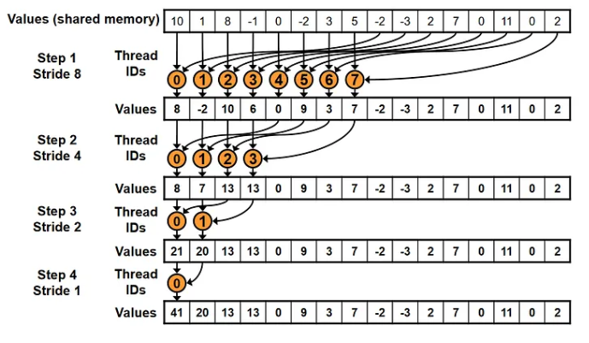

Device Side Convergence Check Through Reduction
The bottleneck for execution time is computing the max temperature change and evaluating convergence. This corresponds to $≈$ 93% of the total execution time.
To speed improve upon this, a second CUDA kernel can be launched performing reduction to generate a much smaller array that needs to be copied back to host memory (65536 elements vs 256 elements).

Slide 11
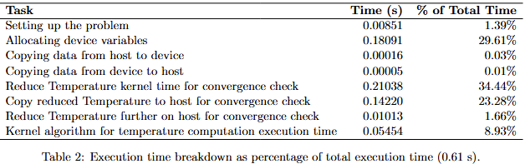
Further Optimizations
While the optimized version significantly improved the execution time (5.97x speedup), the performance can be improved
With an arithmetic intensity of 0.16, shared memory and multiple elements per thread optimizations were implemented with to no avail
However, the kernel functions could be combined to launch a single kernel to compute the new temperature as well as calculate max difference for convergence
Floats were attempted to replace doubles but hindered the final result

Slide 12

Time Complexity of Implementations

